Slide 1
Constructing DFD Model of a System

Slide 2
Construction of DFD
A DFD model of a system graphically represents how each input data is transformed to its corresponding output data through a hierarchy of DFDs.
The DFD model of a system is constructed by using a hierarchy of DFDs as shown in the figure given next.
The top level DFD is called the level 0 DFD or the context diagram. This is the most abstract (simplest) representation of the system (highest level). It is the easiest to draw and understand.
At each successive lower level DFDs, more and more details are gradually introduced.
To develop a higher-level DFD model, processes are decomposed into their subprocesses and the data flow among these subprocesses are identified.

Slide 3
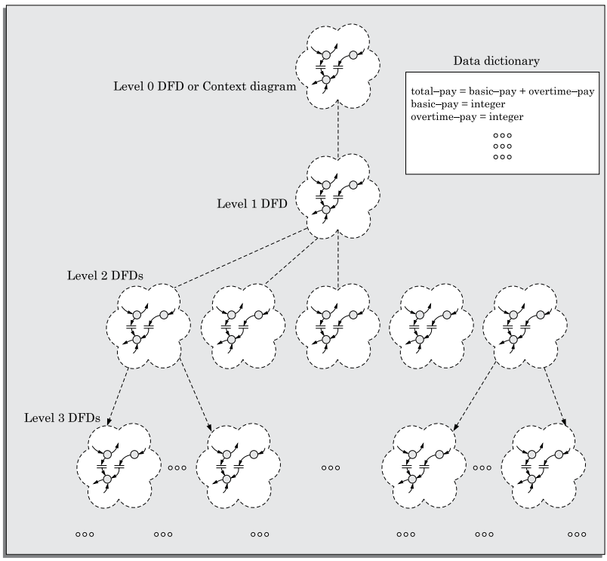
Construction of DFD
To develop the data flow model of a system, first the most abstract representation (highest level) of the problem is to be worked out.
Subsequently, the lower level DFDs are developed.
Level 0 and Level 1 consist of only one DFD each.
Level 2 may contain up to 7 separate DFDs, and level 3 up to 49 DFDs, and so on.
However, there is only a single data dictionary for the entire DFD model.

Slide 4
Context Diagram
The context diagram is the most abstract (highest level) data flow representation of a system. It represents the entire system as a single bubble. The bubble in the context diagram is annotated with the name of the software system being developed (usually a noun). This is the only bubble in a DFD model, where a noun is used for naming the bubble. The bubbles at all other levels are annotated with verbs according to the main function performed by the bubble. This is expected since the purpose of the context diagram is to capture the context of the system rather than its functionality
As an example of a context diagram, consider the context diagram a software developed to automate the book keeping activities of a supermarket. The context diagram has been labelled as ‘Supermarket software’.

Slide 5
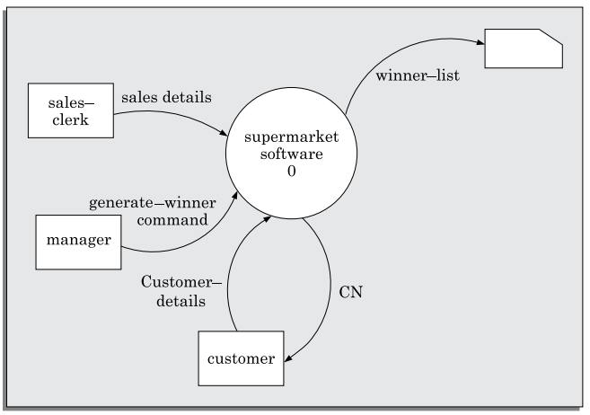
Context Diagram
Context diagram for Super Market Software

Slide 6
Level 1 DFD
The level 1 DFD usually contains three to seven bubbles. That is, the system is represented as performing three to seven important functions.
To develop the level 1 DFD, examine the high-level functional requirements in the SRS document. If there are three to seven high-level functional requirements, then each of these can be directly represented as a bubble in the level 1 DFD.
If a system has more than seven high-level requirements identified in the SRS document, then, some of the related requirements have to be combined and represented as a single bubble in the level 1 DFD. These can be split appropriately in the lower DFD levels.
If a system has less than three high-level functional requirements, then some of the high-level requirements need to be split into their subfunctions so that we have roughly about five to seven bubbles represented on the diagram.

Slide 7
Decomposition
Each bubble in the DFD represents a function performed by the system. The bubbles are decomposed into subfunctions at the successive levels of the DFD model. Decomposition of a bubble is also known as factoring or exploding a bubble.
Each bubble at any level of DFD is usually decomposed to anything three to seven bubbles. A few bubbles at any level make that level superfluous.
For example, if a bubble is decomposed to just one bubble or two bubbles, then this decomposition becomes trivial and redundant.
Too many bubbles (i.e. more than seven bubbles) at any level of a DFD makes the DFD model hard to understand.
Decomposition of a bubble should be carried on until a level is reached at which the function of the bubble can be described using a simple algorithm.

Slide 8
Construction of context diagram
Examine the SRS document to determine:
Different high-level functions that the system needs to perform.
Data input to every high-level function.
Data output from every high-level function.
Interactions (data flow) among the identified high-level functions.
Represent these aspects of the high-level functions in a diagrammatic form. This would form the top-level data flow diagram (DFD), usually called the DFD 0.

Slide 9
Construction of level 1 diagram
Examine the high-level functions described in the SRS document.
If there are three to seven high-level requirements in the SRS document, then represent each of the high-level function in the form of a bubble.
If there are more than seven bubbles, then some of them have to be combined.
If there are less than three bubbles, then some of these have to be split.

Slide 10
Construction of lower-level diagrams
Decompose each high-level function into its constituent subfunctions through the following set of activities:
Identify the different subfunctions of the high-level function.
Identify the data input to each of these subfunctions.
Identify the data output from each of these subfunctions.
Identify the interactions (data flow) among these subfunctions. Represent these aspects in a diagrammatic form using a DFD.
Recursively repeat Step 3 for each subfunction until a subfunction can be represented by using a simple algorithm.

Slide 11
Numbering of bubbles
It is necessary to number the different bubbles occurring in the DFD.
These numbers help in uniquely identifying any bubble in the DFD from its bubble number.
The bubble at the context level is usually assigned the number 0 to indicate that it is the 0 level DFD.
Bubbles at level 1 are numbered, 0.1, 0.2, 0.3, etc.
When a bubble numbered x is decomposed, its children bubble are numbered x.1, x.2, x.3, etc.
In this numbering scheme, by looking at the number of a bubble we can unambiguously determine its level, its ancestors, and its successors.

Slide 12
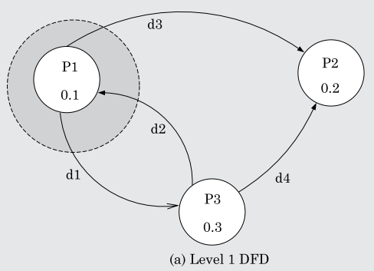
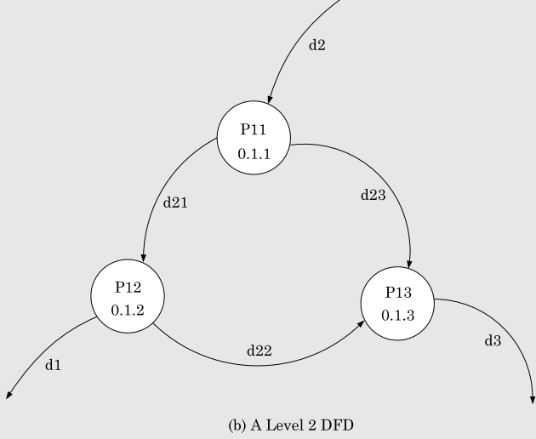
Balancing DFDs
The DFD model of a system usually consists of many DFDs that are organized in a hierarchy. In this context, a DFD is required to be balanced with respect to the corresponding bubble of the parent DFD.
Example:
We illustrate the concept of balancing a DFD in figure next. In the level 1 DFD, data items d1 and d3 flow out of the bubble 0.1 and the data item d2 flows into the bubble 0.1 (shown by the dotted circle). In the next level, bubble 0.1 is decomposed into three bubbles (0.1.1, 0.1.2, 0.1.3).
The decomposition is balanced, as d1 and d3 flow out of the level 2 diagram and d2 flows in.

Slide 13
DFD: RMS Calculating Software
A software system called RMS calculating software would read three integral numbers from the user in the range of –1000 and +1000 and would determine the root mean square (RMS) of the three input numbers and display it.
In this example, the context diagram is simple to draw. The system accepts three integers from the user and returns the result to him. This has been shown in Figure-(a). To draw the level 1 DFD, from a cursory analysis of the problem description, we can see that there are four basic functions that the system needs to perform—
Accept the input numbers from the user,
Validate the numbers,
Calculate the root mean square of the input numbers
Display the result.
After representing these four functions in Figure-(b), we observe that the calculation of root mean square essentially consists of the functions—calculate the squares of the input numbers, calculate the mean, and finally calculate the root. This decomposition is shown in the level 2 DFD in Figure-(c).

Slide 14
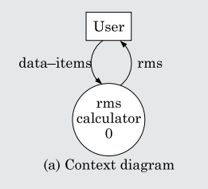
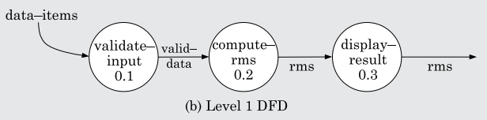
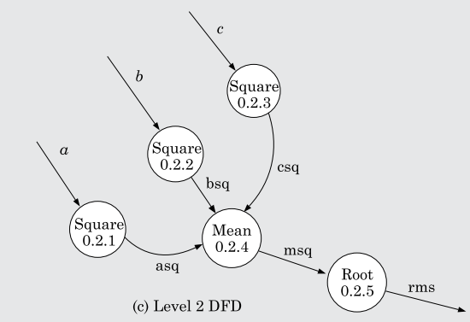
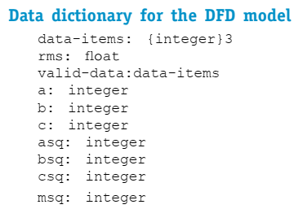
DFD: RMS Calculating Software

